Slide 1
INTRODUCTION
PHP & MySQL for Dynamic Web Sites

Slide 2
What Will You Learn
Basic Syntax
Sending Data to the Browser
Writing comments
What are variables?
Introducing Strings
Concatenating Strings
Introducing Numbers
Introducing Constants
Single vs Double Quotation Marks

Slide 3
Static vs Dynamic vs Web Applications
Website can be static or dynamic.
Static - serves fixed content to all users
Dynamic - serves dynamic content to each user.
In both cases, they are one way information feeds
Web application is two ways. Data is served not only dynamically but also specific to each user with functionality and interactive elements. It’s basically application/software that is web-based.

Slide 4



Static Website

Slide 5

Dynamic Web Site

Slide 6
Web Application

Slide 7
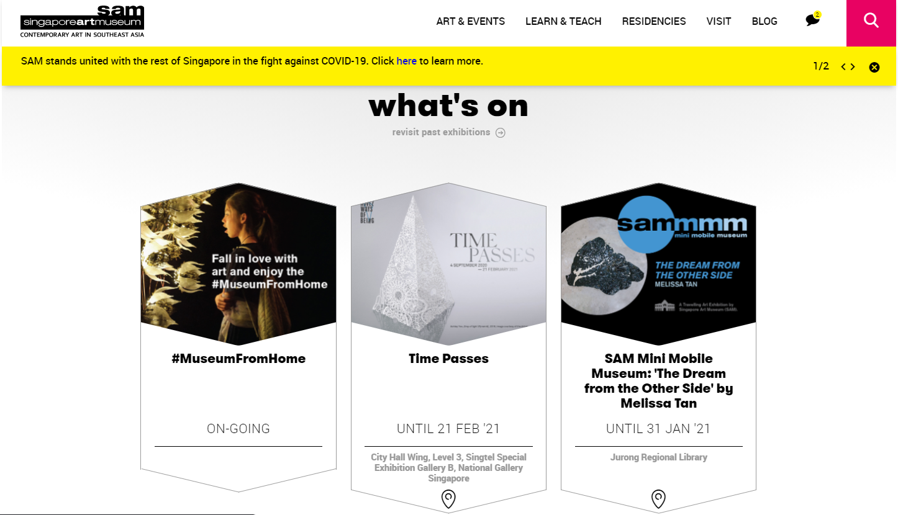
Static Website Example

Slide 8
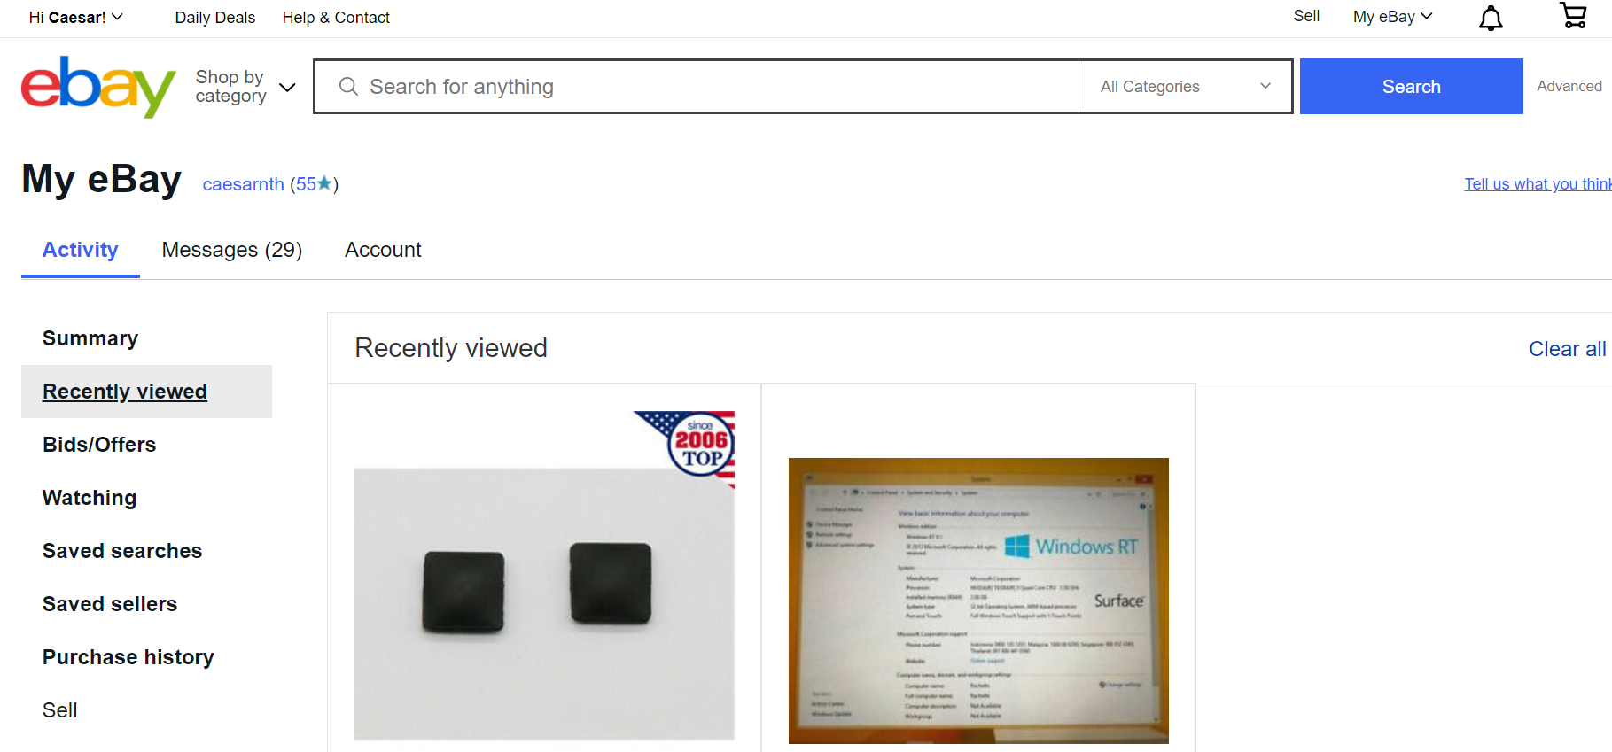
Dynamic Website Example

Slide 9
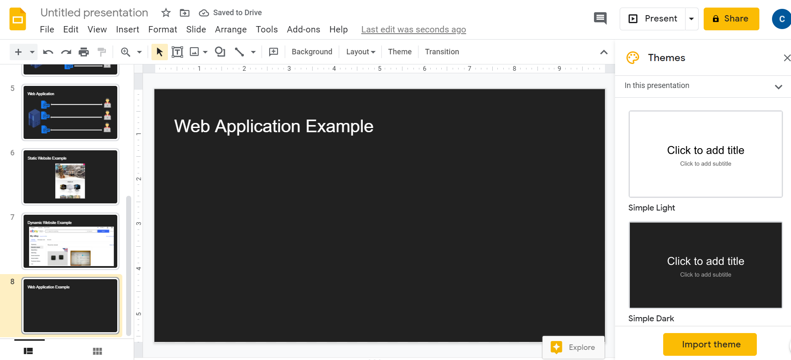
Web Application Example

Slide 10

Question Time
Is Wordpress CMS dynamic website or a web application?

Slide 11
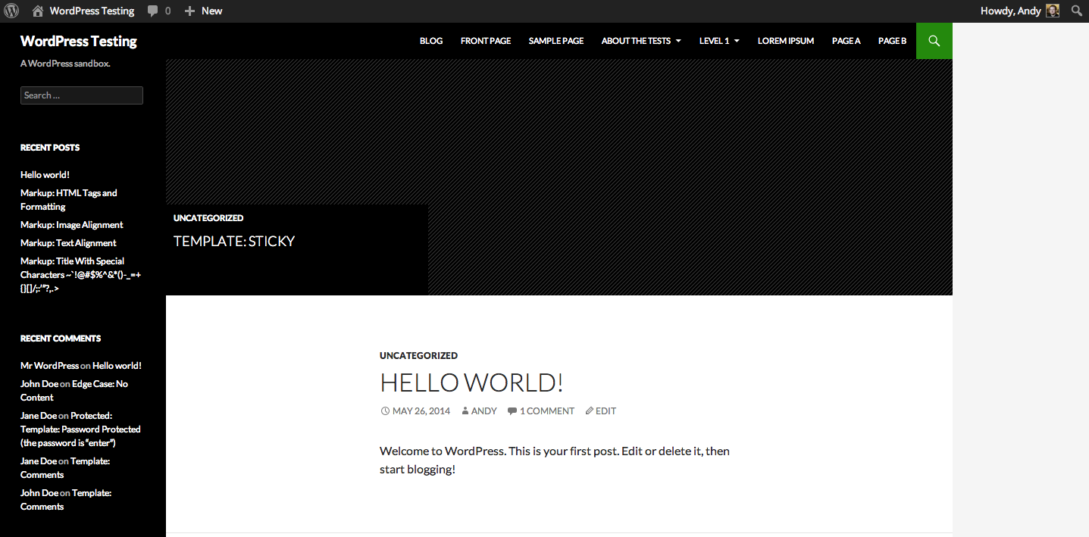
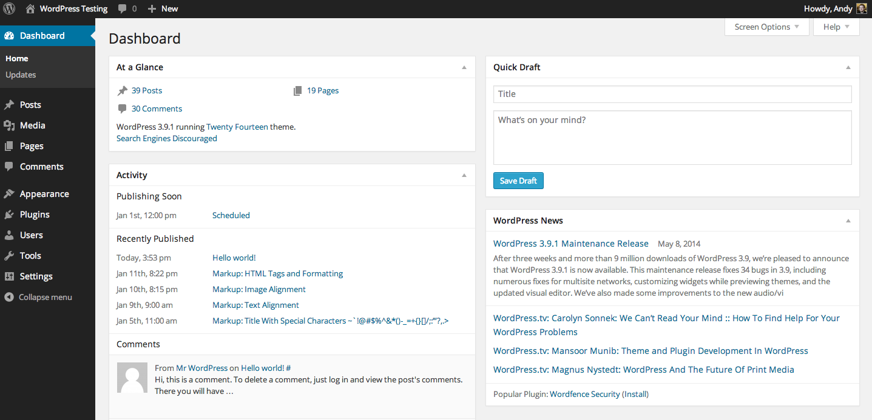
Is Wordpress CMS dynamic website or a web application?
Back-End
Front-End

Slide 12

What is PHP
PHP: Hypertext Preprocessor
PHP is a general-purpose scripting language especially suited to web development
Can be used in three primary ways:
Server-side scripting
Command-line scripting
Client-side GUI applications

Slide 13
Client-server Architecture
Client-server architecture, architecture of a computer network in which many clients (remote processors) request and receive service from a centralized server (host computer)

Slide 14


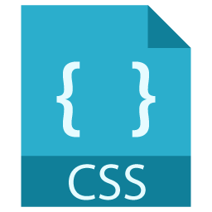
Client-Server Model
HTTP Request
HTTP Respond

Slide 15









Web Languages for Client and Server

Slide 16
LAMP STACK
HTTP Request
Query
HTTP Respond

Slide 17

MEAN STACK
JS runtime engine. NodeJs can create web server.
HTTP Request
Server side JS
Query
HTTP Respond

Slide 18



LAMP vs MEAN
LAMP: Linux, Apache, PHP, MySQL
MEAN: MongoDB, Express, Angular, NodeJS

Slide 19
What Will You Need?
A web server application (Apache, IIS, Nginx etc)
PHP
MySQL
A browser (Chrome, Firefox, Safari, Edge etc)
A Text Editor (Sublime, VS Code, Netbeans, Brackets etc. No notepad++ please)
FTP (Filezilla etc. This is optional)

Slide 20






Setting Up the Development Environment
Install browser
Install XAMPP (or WAMP, MAMP)
Install Text Editor or IDE for coding
(Optional) Postman

Slide 21
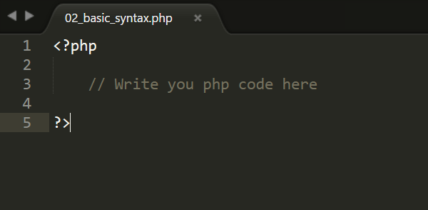
Basic Syntax: to make PHP script

Slide 22
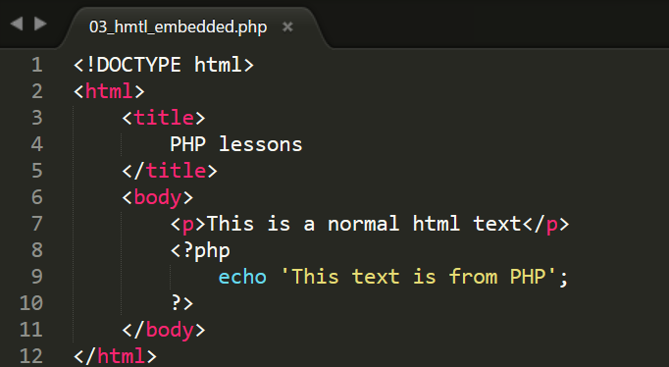
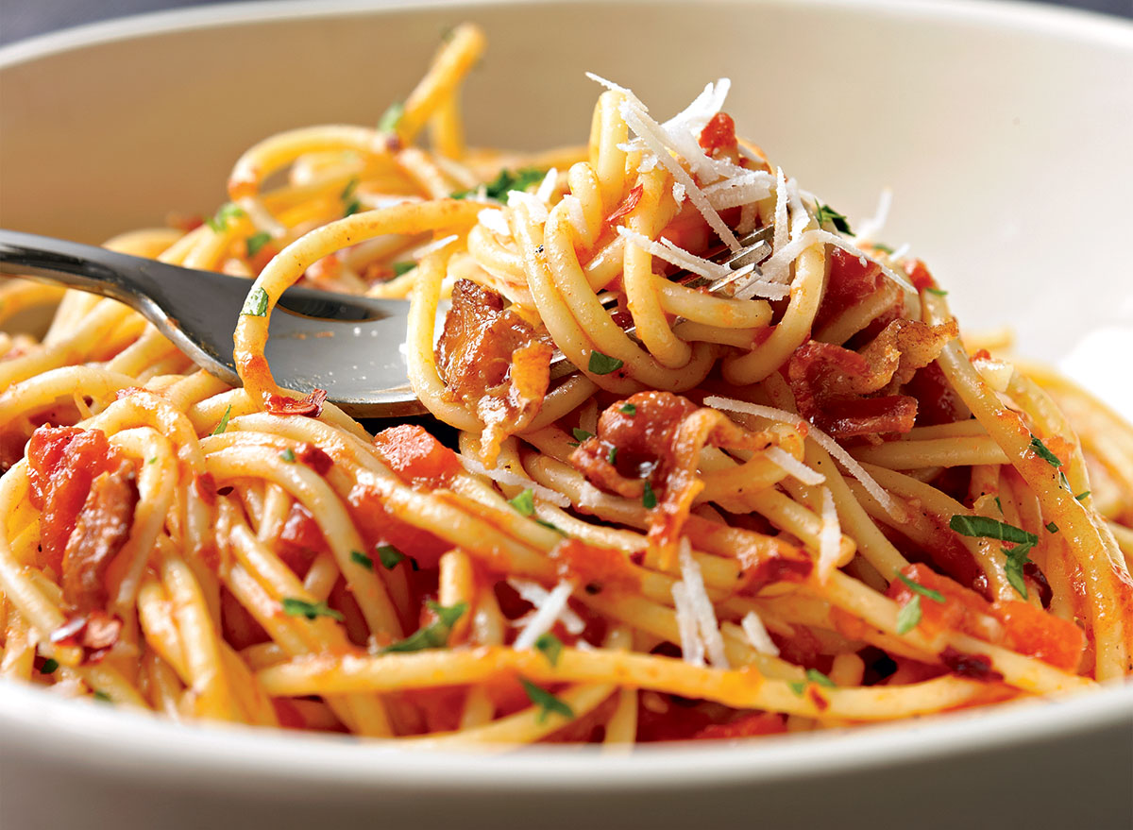
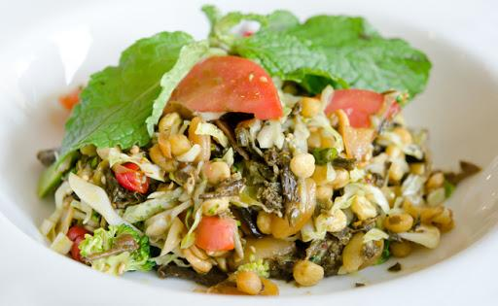
PHP Script Embedded in HTML
This is not a good practice

Slide 23
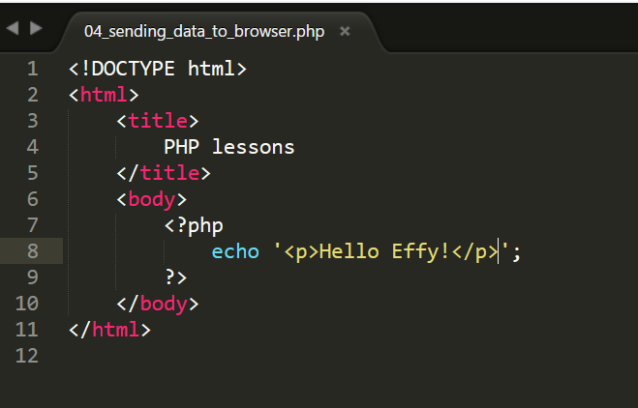
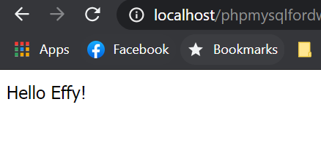
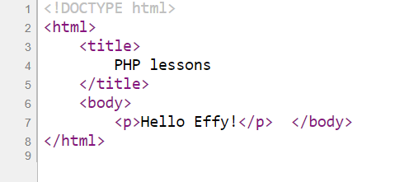
Sending Data to Browser
HTTP Request
localhost://php/sending_data_to_browser.php
HTTP Respond

Slide 24
Sending Data to Browser
How server will send to client
User
How browser will render and display to user
PHP Code
Developer

Slide 25
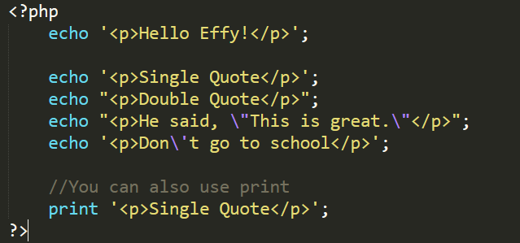
Sending Data to Browser (Output)

Slide 26
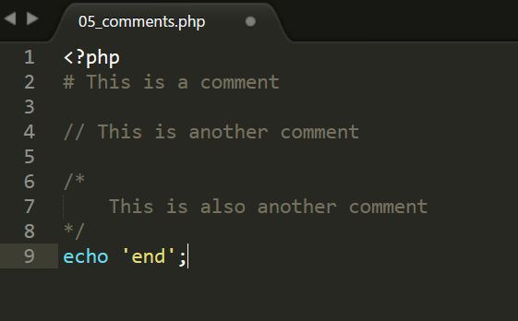
Writing Comments
Line(s) that is not executed as a part of the program
Let others understand your code or yourself in the future

Slide 27
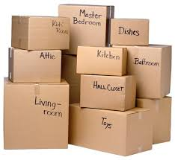
What are variables
Variables are containers used to temporarily store values.
a = 1, b = 2, c = a + b
Syntax: Assign value to a variable Variable Name = Value

Slide 28
Syntactical rules
Must start with dollar sign ($)
Can contain alphanumeric and underscore
First character after $ sign must be underscore or a letter
Case-sensitive. $Name and $name are not the same

Slide 29
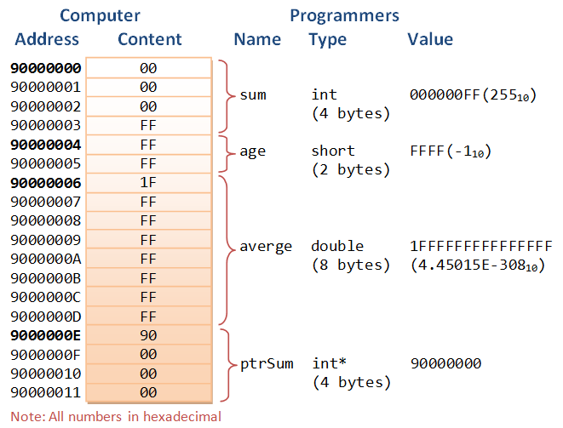
Do You Know Those Numbers?
PHP is a Loosely Typed Language. So you do not need to define data type.

Slide 30
PHP Data Types
Integers: whole numbers, without a decimal point
Floats: decimal or fractional numbers or real numbers
Strings: sequences of characters
Booleans: a switch it has only two possible values either 1 (true) or 0 (false).
Arrays: variable that can hold more than one value at a time
Objects: data type that not only allows storing data but also information on, how to process that data
NULL: variable without any data
Resources: a special variable which holds a reference to an external resource.

Slide 31
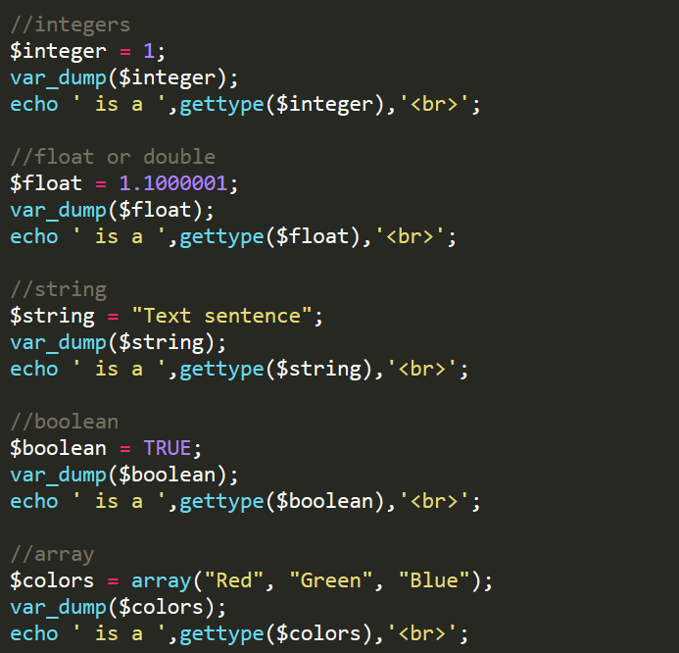
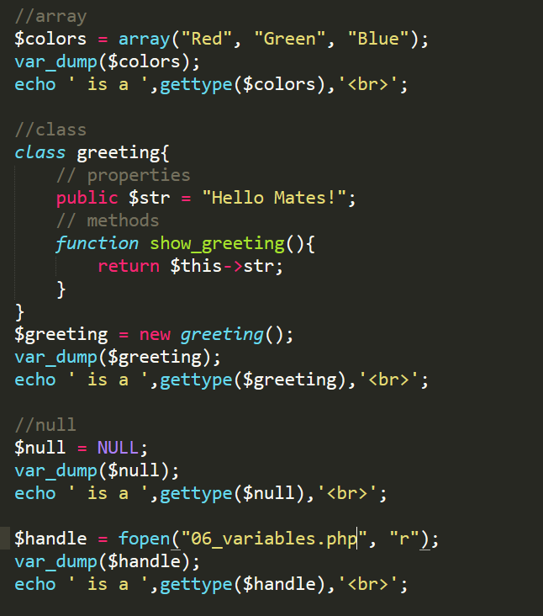
PHP Data Types

Slide 32
Introducing String
Strings are sequences of characters, where every character is the same as a byte.
A string can hold letters, numbers, and special characters and it can be as large as up to 2GB (2147483647 bytes maximum). The simplest way to specify a string is to enclose it in single quotes (e.g. 'Hello world!'), however you can also use double quotes ("Hello world!").

Slide 33
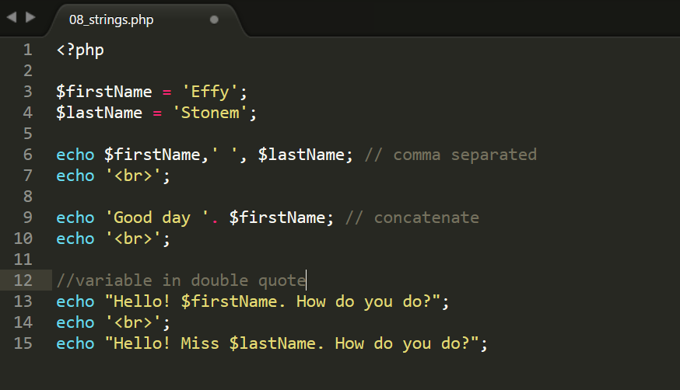
String: Sample Code

Slide 34
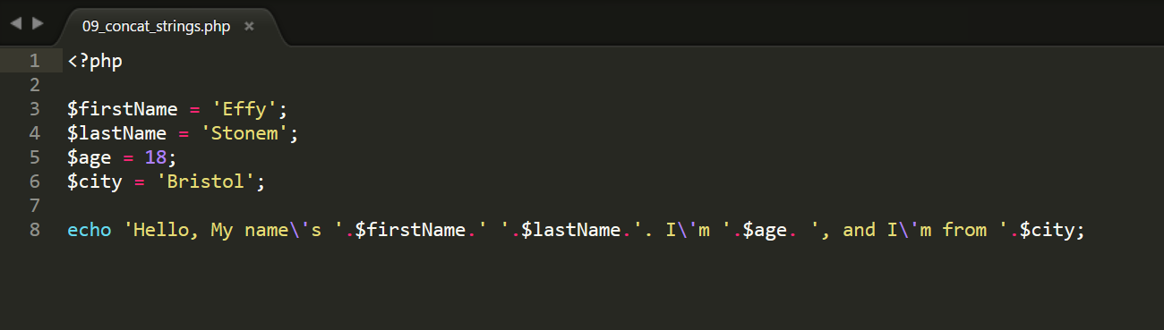
Concatenating Strings

Slide 35
Introducing Numbers
PHP number can be integer(whole) or floating-point (real)
Integers are whole numbers, without a decimal point (..., -2, -1, 0, 1, 2, ...). Integers can be specified in decimal (base 10), hexadecimal (base 16 - prefixed with 0x) or octal (base 8 - prefixed with 0) notation, optionally preceded by a sign (- or +).
Floating point numbers (also known as "floats", "doubles", or "real numbers") are decimal or fractional numbers

Slide 36
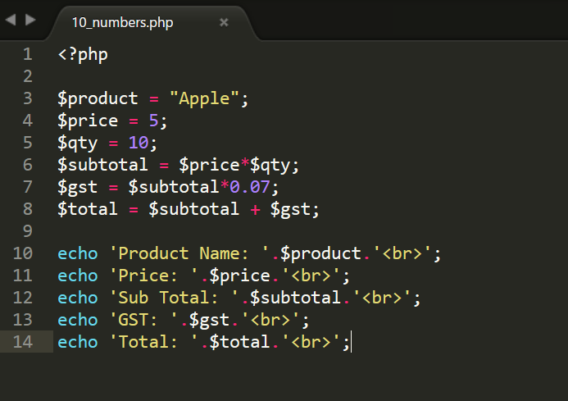
Numbers: Sample Code

Slide 37
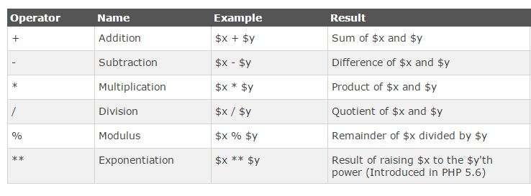
Arithmetic Operators

Slide 38
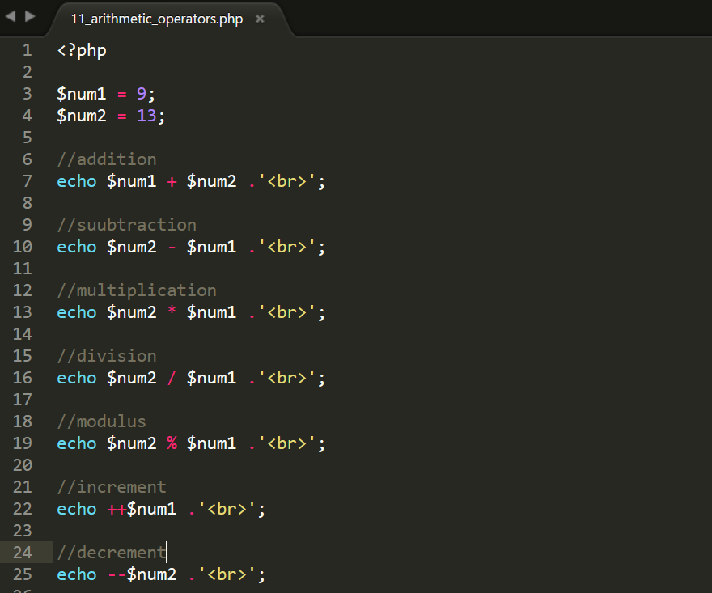
Arithmetic Operators: Sample Code

Slide 39
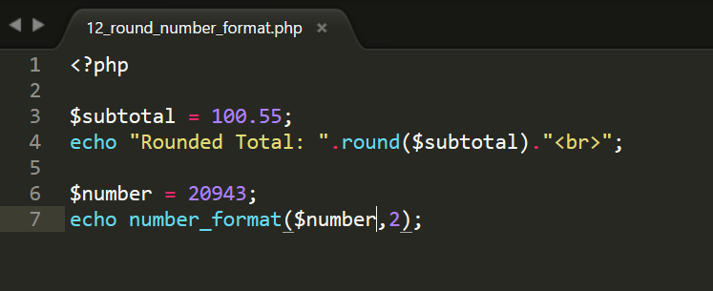
Rounding and Number Format

Slide 40
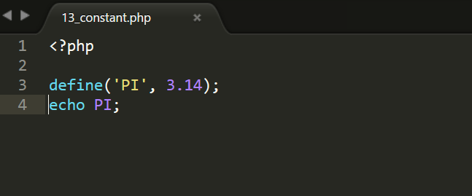
Introducing Constants
A value that cannot be altered by the program during normal execution.
What will happen if you use normal variable to assign the value of pi?

Slide 41
Single vs Double Quotation Mark
Single Quote (‘ ’)
Double Quote (“ “)
Variables are expanded (interpolated) within double quotes, while within single quotes, they are not.
Escape Sequence (\)

Slide 42
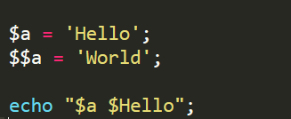
Variable Variables
A variable variable takes the value of a variable and treats that as the name of a variable.

Slide 43

Exercise 1
She just smiled. You know, that Effy smile that means "you don't know me at all, you never will"
Assign that sentence to a variable. Then output it to the browser.

Slide 44
Exercise 2
Write a php code to swap two variables.
For example,
$num1 = 1; $num2 = 2;
Then Echo $num1 // will output 2 Echo $num2 // will output 1

